Slide 1

Prediksi Harga Bitcoin Menggunakan Transformer
Mengintegrasikan Harga, Sentimen, Tren, dan Volume dalam Analisis Deret Waktu Multivariat
Gilang Islamay Putra Djuharis
11190940000055
(Soon to be S.Mat)

Slide 2
Ide Utama
01
02
Analisis Sentimen
Peramalan Deret Waktu

Slide 3
Penelitian Terdahulu
Forecasting
Big Data and Cognitive Computing
Q1
On Forecasting Cryptocurrency Prices: A Comparison of Machine Learning, Deep Learning, and Ensembles
Q1
Predicting the Price of Bitcoin Using
Sentiment-Enriched Time Series Forecasting
Journal of Big Data
Q1
Multivariate cryptocurrency prediction: comparative analysis of three recurrent neural networks approaches
Neural Computing and Applications
Q1
Time-series forecasting of Bitcoin prices using
high-dimensional features: a machine learning approach

Slide 4
Kenapa Mata Uang Kripto?
Bitcoin | Ethereum | SOLANA | XRP | Cardano | Avalanche | Dogecoin

Slide 5

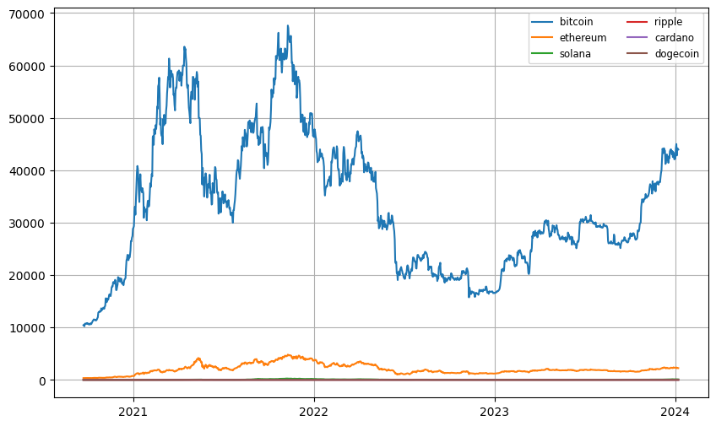
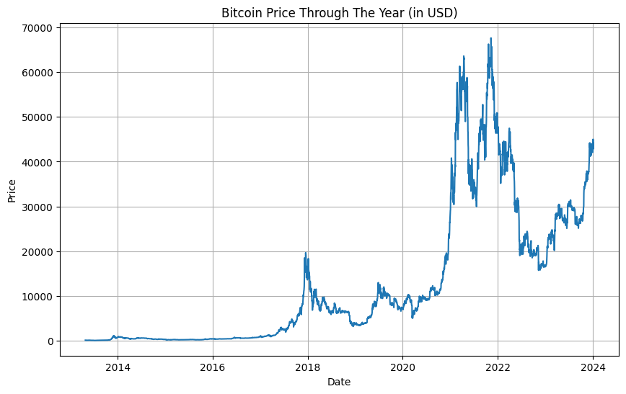
Harga
This Price don’t Lie
(API coingecko.com)

Slide 6
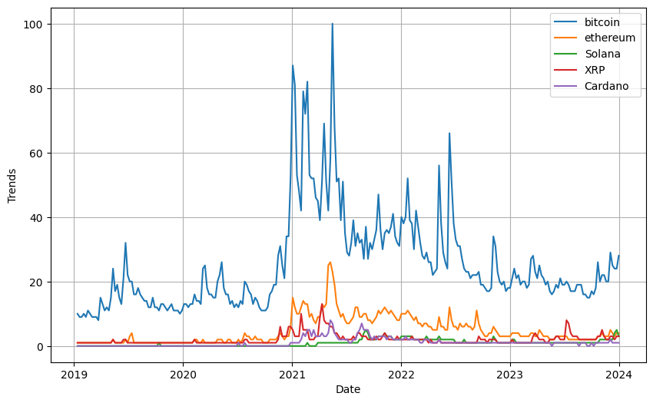
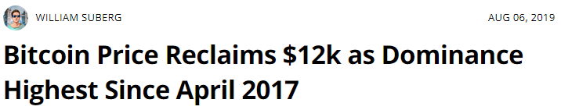
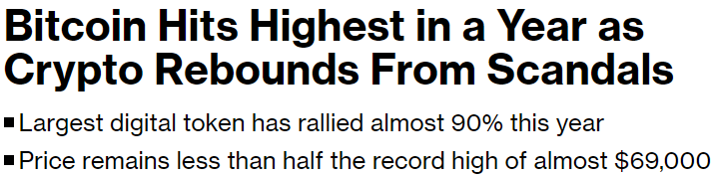
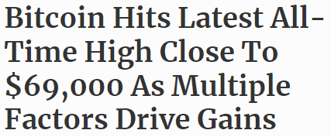
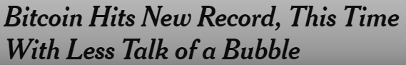
Popularitas
(cointelegraph.com, 2019)
(bloomberg.com, 2023)
(forbes.com, 2021)
(nytimes.com, 2020)
(trends.google.com)

Slide 7

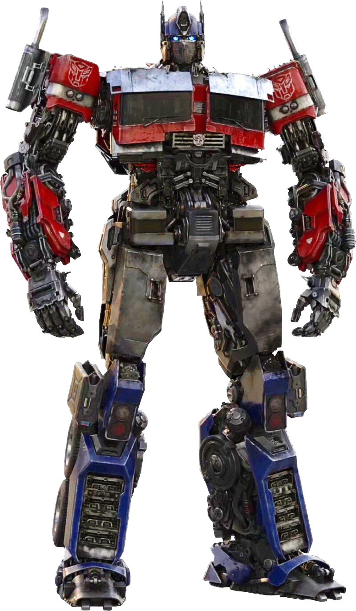
Bagaimana?
By paying attention!

Slide 8
2017
Attention Is All You Need
2018
BERT
2019
roBERTa
2019
Temporal Fusion Transformer

Slide 9
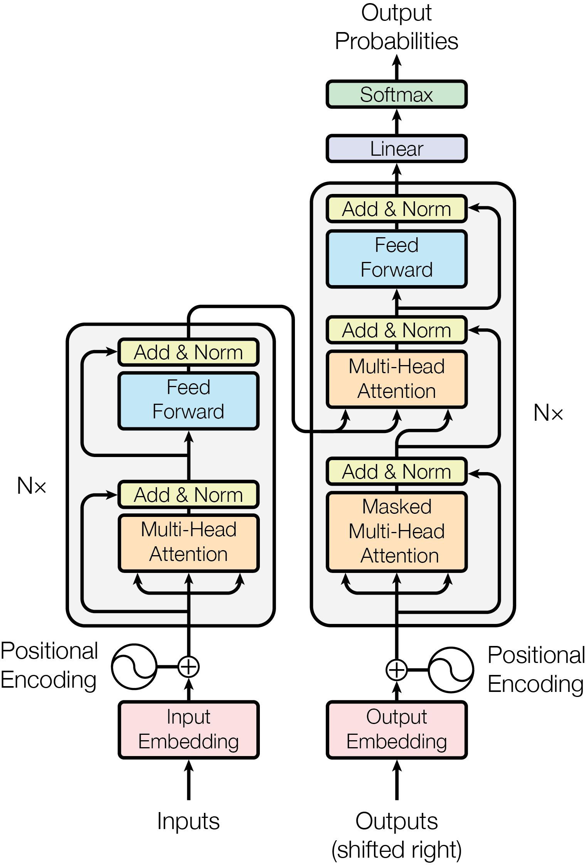
2017
Attention Is All You Need
2018
BERT
2019
roBERTa
2019
Temporal Fusion Transformer
(Attention Is All You Need, 2017)

Slide 10
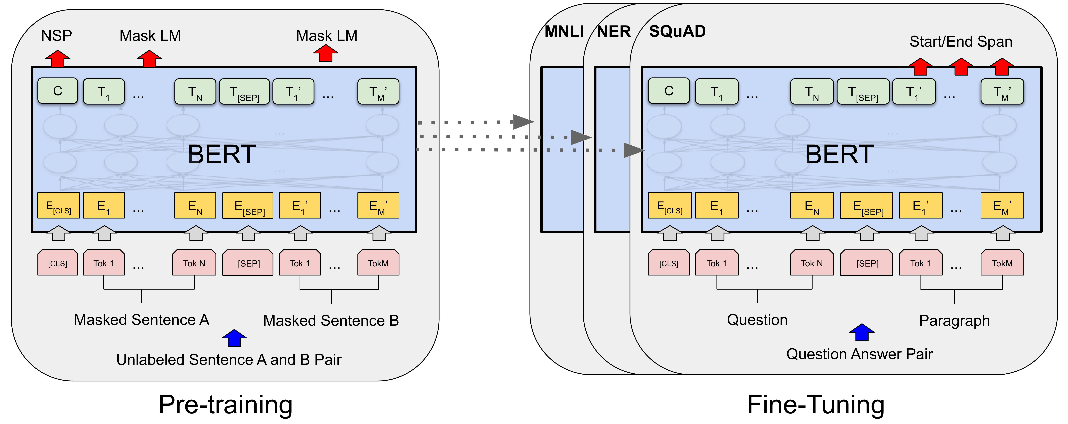
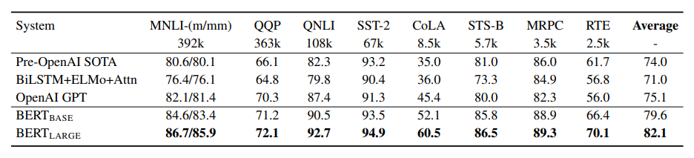
2017
Attention Is All You Need
2018
BERT
2019
roBERTa
2019
Temporal Fusion Transformer
(BERT: Pre-training of Deep Bidirectional Transformers for Language Understanding, 2018)

Slide 11
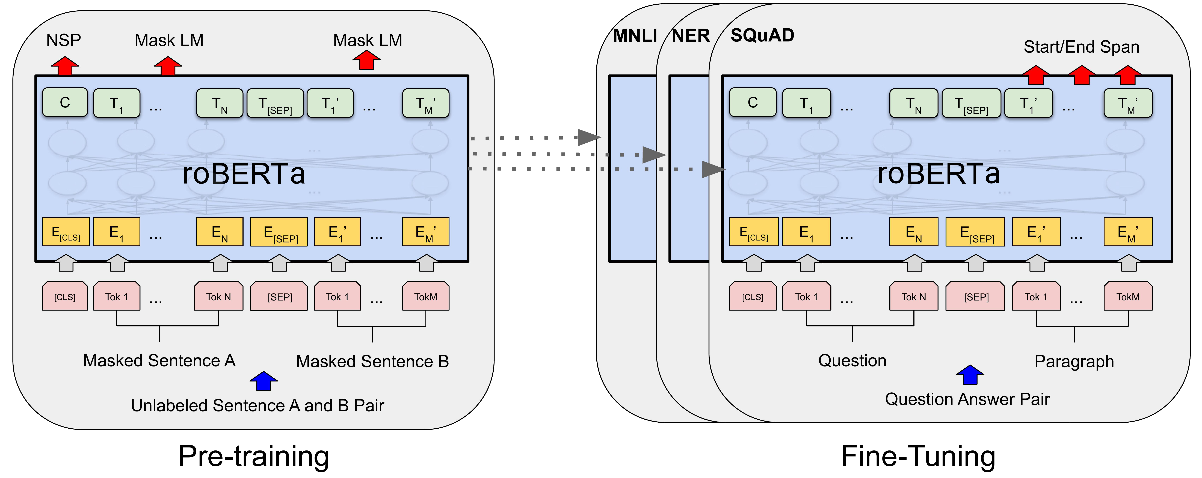
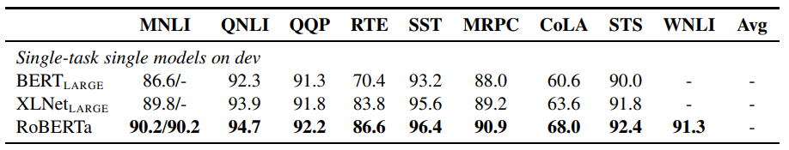
2017
Attention Is All You Need
2018
BERT
2019
roBERTa
2019
(RoBERTa: A Robustly Optimized BERT Pretraining Approach, 2019)
Temporal Fusion Transformer

Slide 12
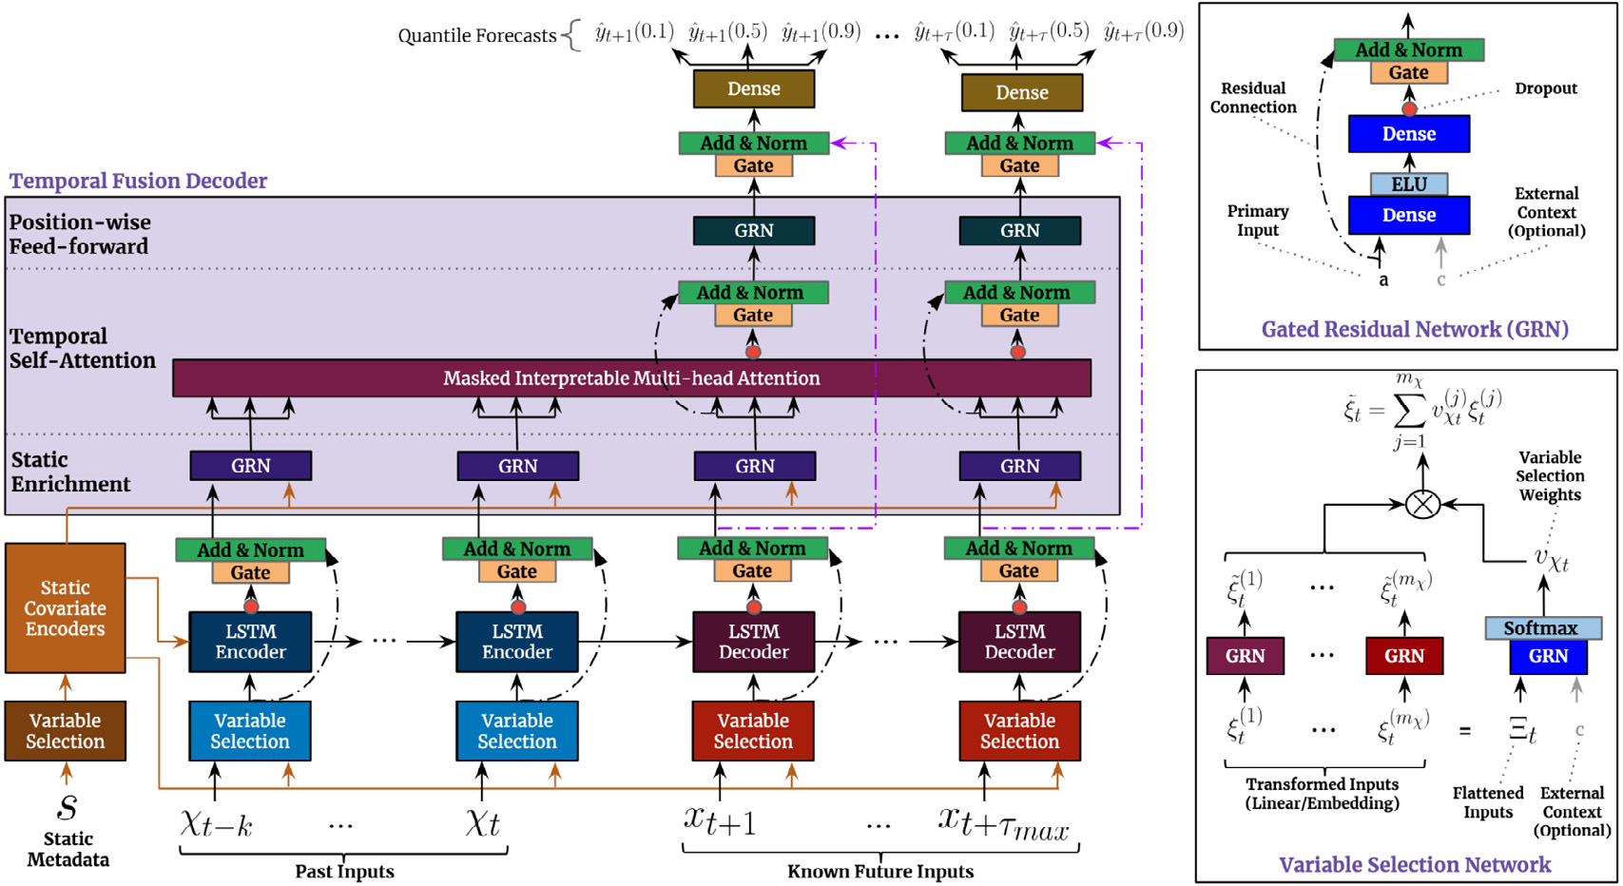
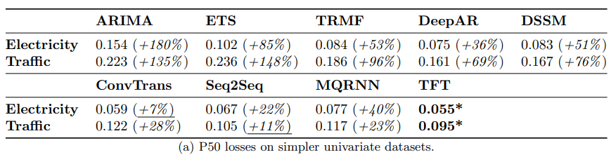
2017
Attention Is All You Need
2018
BERT
2019
roBERTa
2019
Temporal Fusion Transformer
(Temporal Fusion Transformers for Interpretable Multi-horizon Time Series Forecasting, 2019)

Slide 13
Temporal Fusion Transformers
(Temporal Fusion Transformers for Interpretable Multi-horizon Time Series Forecasting, 2019)

Slide 14
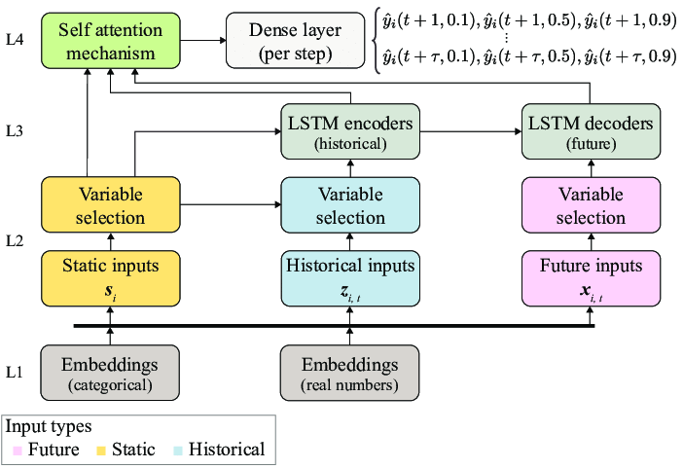
Temporal Fusion Transformers
(Extreme Precipitation Seasonal Forecast
Using a Transformer Neural Network, 2021)

Slide 15
Jalur Penelitian
Prapemrosesan Data Teks
Membangun Model Analisis Sentimen
Prapemrosesan Data Seri Waktu
Pelabelan Manual Data Teks dan Augmentasi
Pelabelan Data Teks Menggunakan Model
Membangun Model Peramalan Seri Waktu

Slide 16
Analisis Sentimen
01
Tujuan
Membangun model klasifikasi
sentimen terhadap topik Bitcoin

Slide 17
Prapemrosesan Data Teks
Penghapusan URLS dan Entitas HTML
01
02
03
04
05
06
Penyelarasan
Huruf Kecil
Tokenisasi
Penghapusan Tanda Baca dan Kata - Kata Penghubung
Penghapusan Karakter Spesial dan Angka
Lematisasi

Slide 18
Penghapusan Tweet yang bersifat Spam
date | Text
2021-07-03 20:53:51 | The $BTC price is at $34655.23 right now. 🔴 Compared to the last tweet, the price has dropped by $72.77 (-0.21%). 🟢 In the last 24 hours the price has increased by $1488.36 (4.49%). #Bitcoin #BTC https://t.co/5wDhcU31UB
2021-10-19 09:16:20 | 🐳🚨 Bitcoin Whale Alert: [ TX: 6e2f93751abd08b63306d5351da016187927ac712f442d6709d23d10b01e83c8 ]-[ ADDR: 1DuhtLa8TtCC547WfSNLHZvT91b9PQQeDD ]-[ #BTC: 16.68212472 ]-[ BLOCK_DATE: 2021-10-19 10:37:49 ] #btc_whale_alert #bitcoin- BTC_Whale_Alert
2021-06-21 07:43:39 | WhaleTrades: 📈💰$2,500,000 #bitcoin LONGED @$32,805.8359 [21/06/21 07:34:55] 🏤BitMEX | $XBTUSD 💬I’d take a fast nickel over a slow dime - buyerofblood
2022-04-16 15:59:12 | 💰 Market Cap. Swap 💰 What would one #Ecash $XEC cost if it had the market capitalization of #Bitcoin $BTC? One #XEC would be worth $0.0401409. 🤑 💪 🚀 | 👁️ More: https://t.co/fSCkKGmhcK… https://t.co/rmygNBMIhr

Slide 19
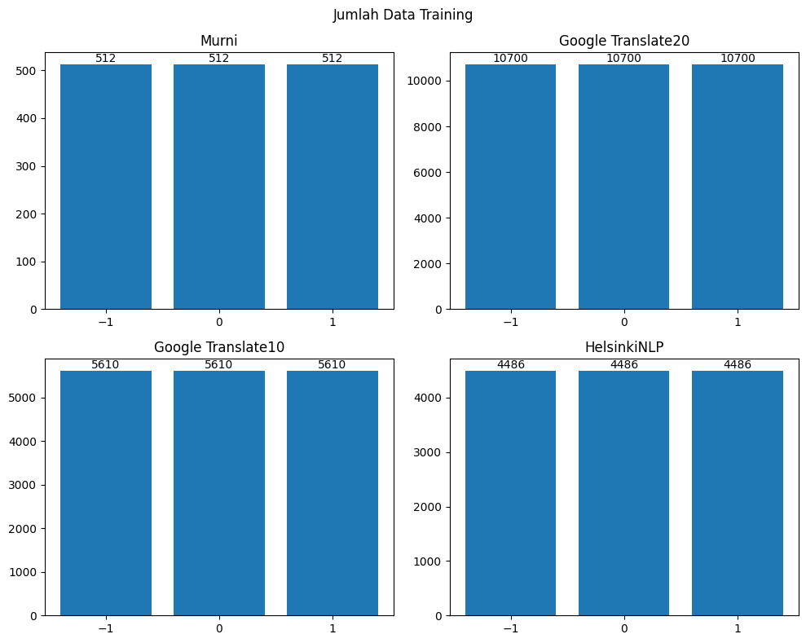
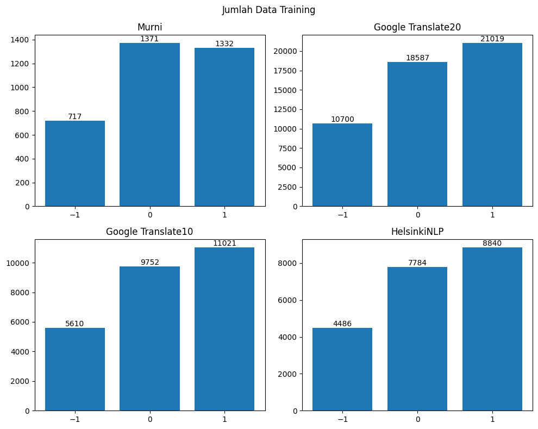
Pelabelan Data Teks dan Augmentasi
Google Translate20
Google Translate10
Top 20 Skor BLEU Tertinggi di Google Translate
Top 10 Skor BLEU Tertinggi di Google Translate
HelsinkiNLP
Model Translasi dari Universitas Helsinki

Slide 20
Membangun Model Analisis Sentimen
Model | Acc Negative Sentiment | Acc Neutral Sentiment | Acc Positive Sentiment | Overall Accuracy
twitter-roberta-base-sentiment-latest | 0,59 | 0,72 | 0,27 | 0,526666667
bertweet-base-sentiment-analysis | 0,53 | 0,75 | 0,24 | 0,506666667
finbert | 0,05 | 0,06 | 0,91 | 0,34
twitter-xlm-roberta-base-sentiment | 0,52 | 0,7 | 0,3 | 0,506666667
cryptobert | 0,37 | 0,56 | 0,59 | 0,506666667
twitter-xlm-roberta-bitcoin-sentiment | 0,47 | 0,51 | 0,38 | 0,453333333

Slide 21
Fine Tuned
Model | Sebelum Fine Tuning | Murni | GT20 | GT10 | HelsinkiNLP | Improvement
bertweet-base-sentiment-analysis | 0,5066667 | 0.626667 | 0. 666666 | 0. 666666 | 0.656667 | +31.62%
Cryptobert | 0,5066667 | 0.666666 | 0.673333 | 0.676667 | 0.646667 | +33.60%
twitter-roberta-base-sentiment-latest | 0,5266667 | 0.653333 | 0.65 | 0.646667 | 0.64 | +24.14%
twitter-xlm-roberta-base-sentiment | 0,5066667 | 0.606667 | 0.596667 | 0.616667 | 0.62 | +22.53%

Slide 22
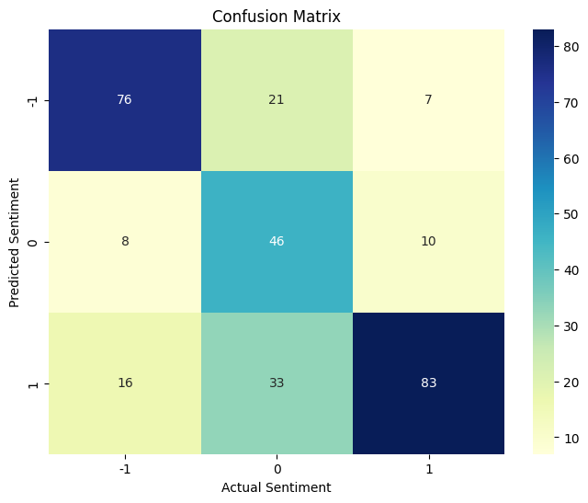

Introducing CryptobertRefined
Sentiment Score | Precision | Recall | F1-Score | n
-1 | 0,73 | 0,76 | 0,75 | 100
0 | 0,72 | 0,48 | 0,56 | 100
1 | 0,63 | 0,83 | 0,72 | 100
Accuracy | 0,68 |  |  | 300
Macro Avg | 0,69 | 0,68 | 0,67 | 300
Weighted Avg | 0,69 | 0,68 | 0,67 | 300

Slide 23
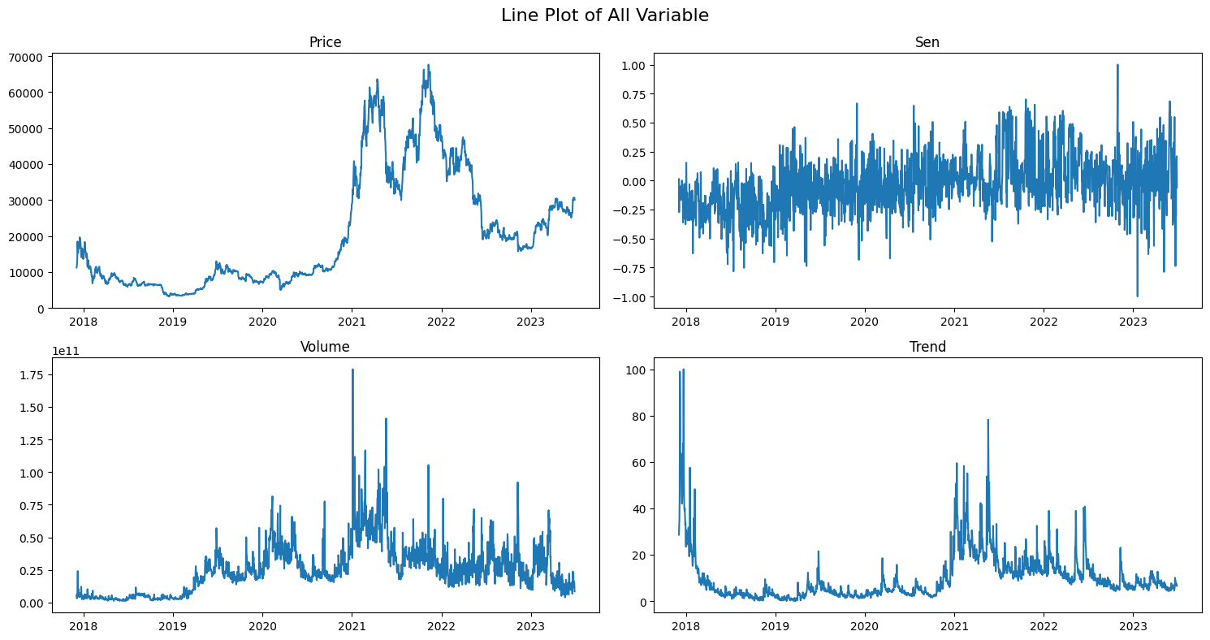
Pelabelan Data Teks menggunakan Model

Slide 24

02
Time Series Forecasting
Let’s do some Forecasting!
Tujuan
Membangun model Peramalan
Seri Waktu Harga Bitcoin

Slide 25
Prapemrosesan Data Deret Waktu
01
02
03
Outlier Detection
Outlier Handling
Isolation Forest
Simple Moving Average
04
Stationary Test
Transformation
Augmented Dickey-Fuller Test
Differencing Transformation

Slide 26
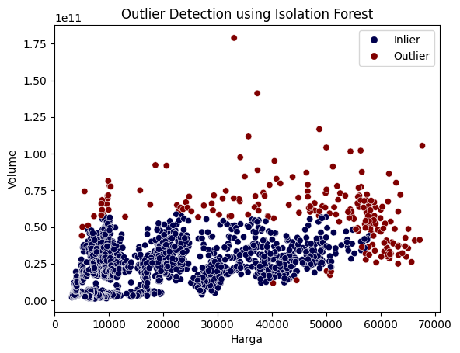
Outlier Detection dan Handling
Terdapat 204 outlier!

Slide 27
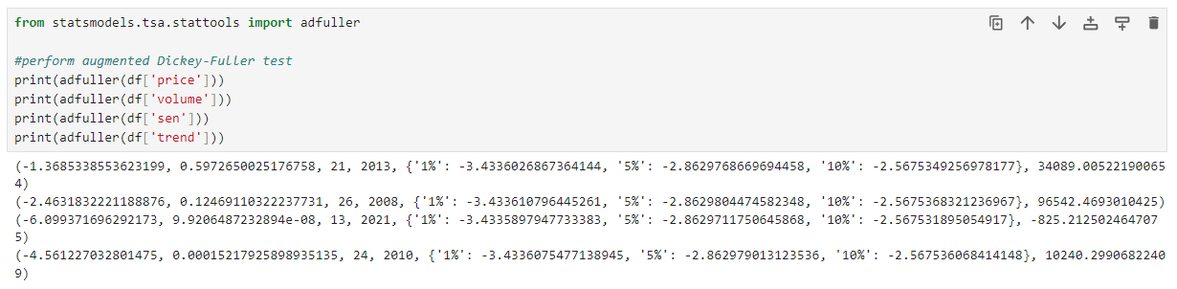
Stationary Test

Slide 28
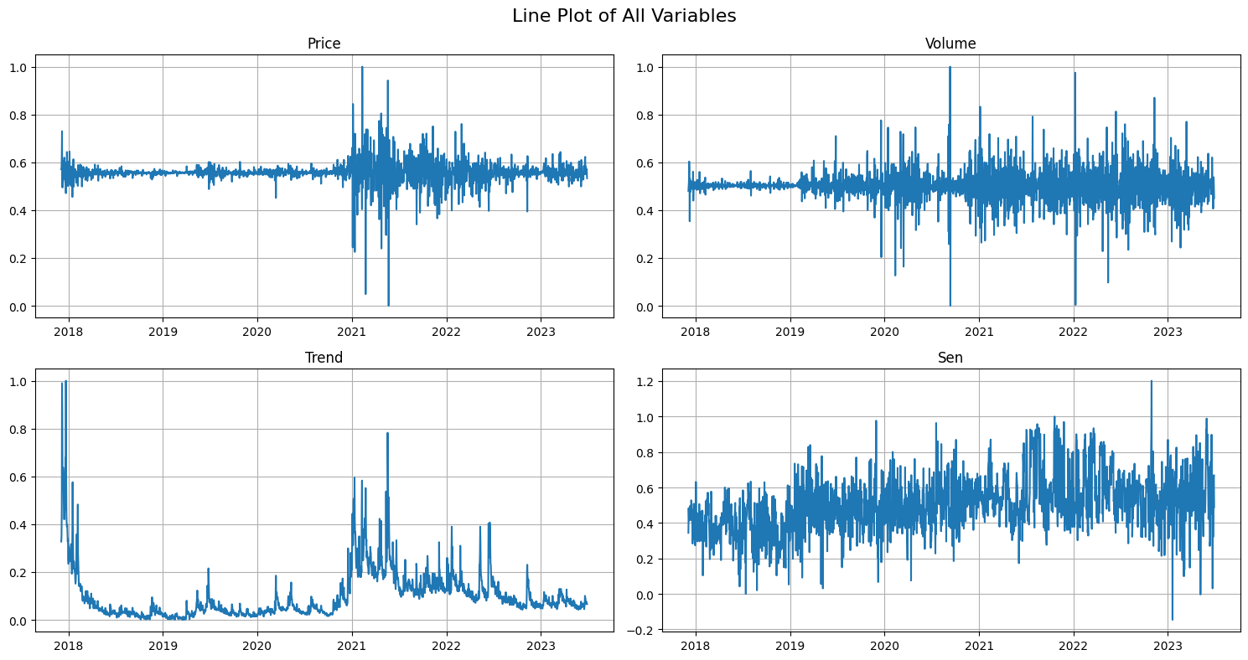
Differencing Transformation The First Order! With some Spice

Slide 29
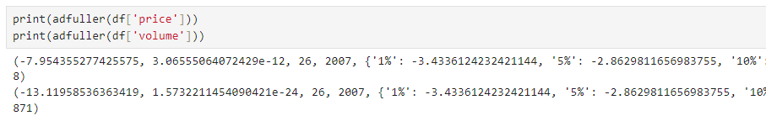
Stationary Test

Slide 30
FORECASTING!

Slide 31
Model Peramalan Seri Waktu Harga Bitcoin
Model | Moving Average |  |  | Box Plot |  |  | Pelatihan (s)
 | RMSE | MAE | MAPE | RMSE | MAE | MAPE
TFT | 0,0261 | 0,0177 | 3,0973 | 0,0463 | 0,0312 | 6,7257 | 166,14
TFT_{w/o} | 0,0263 | 0,0176 | 3,0737 | 0,0479 | 0,0316 | 6,9818
TCN | 0,0263 | 0,0175 | 3,0627 | 0,0477 | 0,0322 | 7,0084 | 46,94
TCN_{w/o} | 0,0262 | 0,0172 | 3,0166 | 0,048 | 0,0318 | 7,0042
GRU | 0,0262 | 0,0175 | 3,0764 | 0,0475 | 0,0316 | 6,9442 | 77,98
GRU_{w/o} | 0,0263 | 0,0175 | 3,0678 | 0,0479 | 0,0318 | 7,025
LSTM | 0,0262 | 0,0174 | 3,0532 | 0,0477 | 0,0314 | 6,9306 | 74,05
LSTM_{w/o} | 0,0264 | 0,0174 | 3,0469 | 0,0479 | 0,0317 | 7,0063

Slide 32
EXPLAINABILITY!

Slide 33
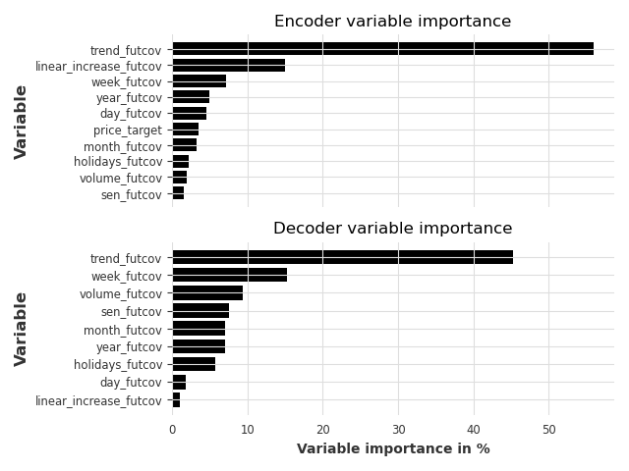
Variable Importance
Type | Encoder | Decoder
sen_futcov | 0,02 | 0,08
volume_futcov | 0,02 | 0,09
holidays_futcov | 0,02 | 0,06
month_futcov | 0,03 | 0,07
price_target | 0,04 | -
day_futcov | 0,05 | 0,02
year_futcov | 0,05 | 0,07
week_futcov | 0,07 | 0,15
linear_increase_futcov | 0,15 | 0,01
tren_futcov | 0,56 | 0,45

Slide 34
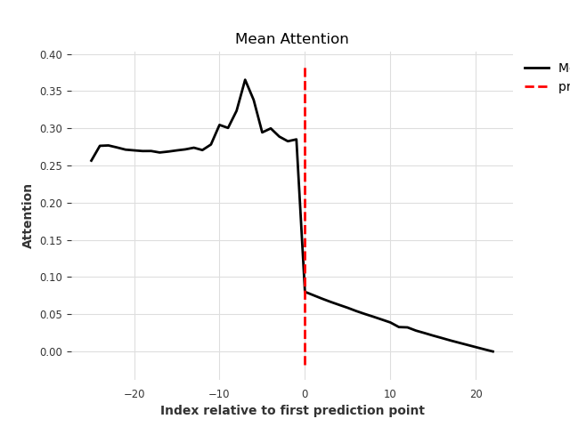
Attention Horizon

Slide 35
EXPERIMENT!

Slide 36
Model Peramalan Seri Waktu Harga Bitcoin
Model | RMSE | MAE | MAPE
TFT (Dengan semua variable) | 0,0261 | 0,0177 | 3,097
TFT (Tanpa Sentiment dan Volume) | 0,0258 | 0,0173 | 3,033

Slide 37
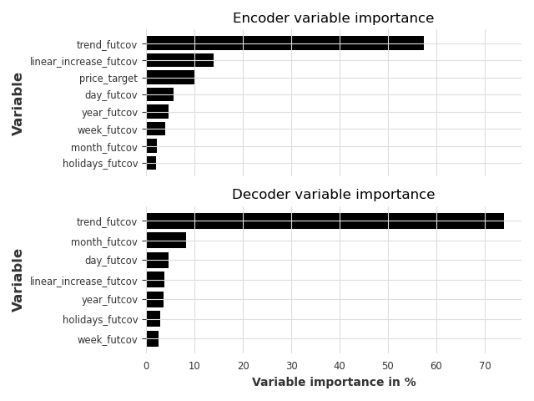
Variable Importance
Type | Encoder | Decoder
holidays_futcov | 0,02 | 0,03
month_futcov | 0,02 | 0,08
week_futcov | 0,04 | 0,03
year_futcov | 0,05 | 0,04
day_futcov | 0,06 | 0,05
price_target | 0,1 | -
linear_increase_futcov | 0,14 | 0,04
tren_futcov | 0,58 | 0,74

Slide 38
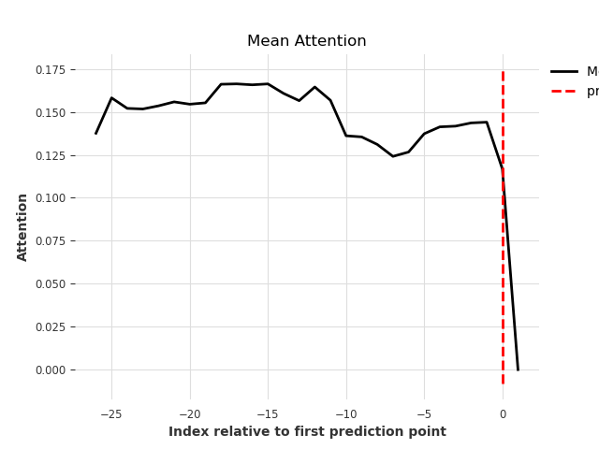
Attention Horizon

Slide 39
Kesimpulan
Augmentasi Data
Data Quality
Back-Translation dan
Easy Data Agumentation
Google Translate dan HelsinkiNLP
Explainability
Variable
Kepentingan Encoder Decoder dan Attention
Sentimen, Volume, Trend, dan variabel statis
Forecasting Model
TFT, LSTM, GRU, & TCN

Slide 40
Thank You
“Any Sufficiently Advanced Technology is Indistinguishable from Magic”
- Arthur C. Clarke

Slide 41
Thank You
“Barang siapa yang menjadikan mudah urusan orang lain, pasti Allah akan memudahkannya di dunia dan di akhirat.” (HR. Muslim)

